Slide 1
NIOSH UPDATE
Dr. Christine Branche

Slide 2
Construction Fall Prevention Campaign
Goal
To provide small residential construction contractors and owners with the information, motivation, and support they need for them to create the necessary conditions for their workers to work safely at heights.

Slide 3
How the campaign developed
NORA Construction Sector Council-led
Campaign leaders: NIOSH, OSHA and CPWR—The Center for Construction Research and Training
Evidence-based campaign
Evaluation essential to demonstrate success
Notes:
The Campaign to Prevent Falls in Construction is a joint effort by government-labor-management effort occurring through the National Occupational Research Agenda (NORA) under the auspices of NIOSH. We wanted to address the top cause of construction industry fatalities.

Slide 4
Intended Audience
Primary: Small residential construction contractors
Secondary: Supervisors and foremen for these contractors
Tertiary: Workers for these contractors, including Spanish speakers

Slide 5
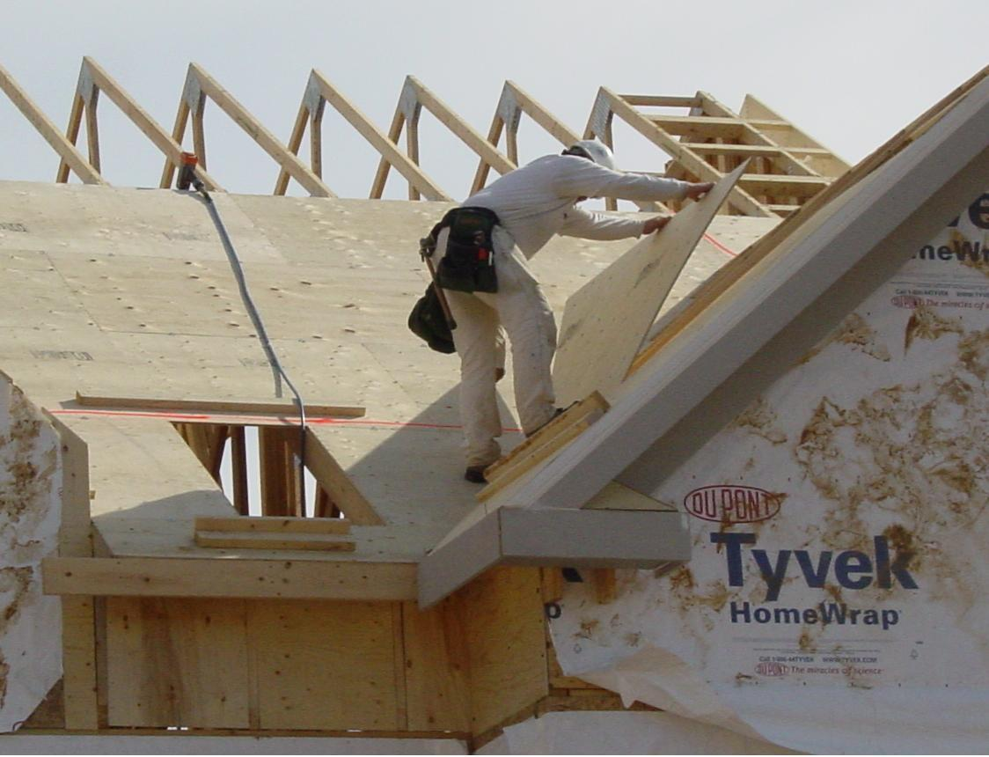
Why Focus on Falls?
Notes:
We know that unsafe practices are happening every day. We know that because of the statistics …
And we know that falls in construction take the primary toll …

Slide 6
Distribution of Leading Causes of Fatalities in Construction, 2010, All Employment
Exposure (15.7%)
Contact with/ objects (17.6%)
Transportation (26.1%)
Source: The Construction Chart Book, Fifth Edition, CPWR 2013 using BLS data.
Notes:
Description of chart … This information and the following charts are from The Construction Chart Book. The fifth edition will be coming out later this month. Pete Stafford will fill you in on it during his presentation.
NOTES of explanation: Total may not add to 100% due to rounding. “Transportation” refers to injuries involving vehicles – due to collision or other type of traffic accident, loss of control, or a sudden stop, start, or jolting of a vehicle regardless of the location where the event occurred. “Contact with objects” includes being struck by an object, struck against an object, caught in or compressed by equipment or objects, and caught in or crushed by collapsing materials. “Exposure” includes exposure to electric current; temperature extremes; air pressure changes; caustic, noxious, or allergenic substances; and harmful substances and environments. “Other” includes fires and explosions; assaults and violent acts, including self-inflicted injuries, assaults, and assaults by animals; and bodily reactions/exertion, such as when startled; and other non-classifiable events or exposures.

Slide 7
Top Killers among Falls in Construction, 2008-2010, All Employment
Source: The Construction Chart Book, Fifth Edition, CPWR 2013 using BLS data.
This research was conducted with restricted access to Bureau of Labor Statistics (BLS) data. The views expressed here do not necessarily reflect the views of the BLS.
Notes:
Data in graphic: Causes of fatalities from falls in construction, 2008-2010 total, All employment
The largest fall fatality hazards:
Roofs ~1/3rd
Ladders nearly a quarter
Scaffolds about 15%
These 3 issues combined account for roughly 2/3 of all fatal falls in construction.
“Other” causes include jump to a lower level; fall on the same level; fall to a lower level unspecified; and fall down stairs or steps. Total may not add to 100% due to rounding.

Slide 8
Top Causes of Nonfatal Injuries from Falls resulting in Days Away from Work in Construction, 2010, Private, Wage & Salary workers
Other (20.9%)
On same level (39.5%)
From scaffold (3.6%)
From roof (7.3%)
From ladder (22.9%)

Slide 9
Fatalities from Falls in Construction, by Establishment Size, 2008-2010, Wage & Salary Workers
Source: The Construction Chart Book, Fifth Edition, CPWR 2013 using BLS data.
This research was conducted with restricted access to Bureau of Labor Statistics (BLS) data. The views expressed here do not necessarily reflect the views of the BLS.
Notes:
One reason we are reaching out to small contractors may be obvious when you see this chart. More than half of all fatal falls occur among employees of small contractors, or companies having 10 or fewer employees. This was disproportionally high, given that fewer than 30% of construction workers were employed in establishments of this size. Hence our focus on small residential contractors as the primary target audience.

Slide 10
Construction Fall Fatalities
 | 2008 | 2009 | 2010
Total Number of Construction Fatalities | 975 | 834 | 774
Falls to lower level | 328 | 276 | 255
Fall from roof | 100 | 86 | 90
Fall from Scaffold | 52 | 41 | 37
Fall from Ladder | 66 | 74 | 68
Source: BLS CFOI Data
Notes:
Why we need a fall prevention campaign for construction.
FALLS ARE THE LEADING CAUSE OF DEATH IN CONSTRUCTION. In 2010, there were 255 fall fatalities and 10,000 injuries. Falls have consistently accounted for a large proportion of fatalities and about 10,000 non-fatal injuries in construction over time. These injuries and deaths are preventable.
The fall prevention campaign focuses on raising employee awareness of common fall hazards in construction with the message Safety Pays - Falls Cost, and how falls from roofs, ladders, scaffolds (the three leading causes of fall fatalities in construction) can be prevented and lives can be saved through three simple steps for contractors: Plan, Provide and Train.
PLAN ahead to get the job done safely.
PROVIDE the right equipment
TRAIN everyone to use the equipment safely
Note: Falls from roofs, ladders and scaffolds accounted for approximately 74% of all fall fatalities in 2010

Slide 11
Most Frequently Cited Serious Violations in Construction
Fall protection – Residential construction 6’ or more
Portable ladders 3 feet above landing surface
Fall protection - Unprotected sides & edges
Head protection
Standard & Subpart - 1926.
Fall hazards training program
Eye & face protection
Aerial Lifts - Body belt and lanyard
Scaffolds - Fall protection
Scaffolds - Access
Scaffolds - Platform construction
Notes:
Eight of these ten leading serious violations are related to falls and fall protection.

Slide 12
Fall Prevention Campaign –
Our Messages
PLAN ahead to get the job done safely
PROVIDE the right equipment
TRAIN everyone to use the equipment safely
… because Safety Pays Falls Cost
Notes:
Our research shows the main causes of fall deaths and injuries, but so too does research pave the way to solutions …
PLAN ahead to get the job done safely
PROVIDE the right equipment for the task at hand
TRAIN everyone to use the equipment safely
In this way, safety pays, falls cost.

Slide 13
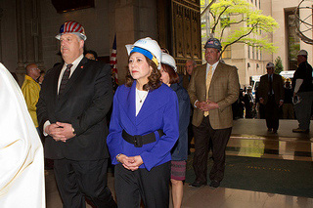
Construction Falls Prevention Campaign
National two-year campaign launched on Workers’ Memorial Day 2012 by
Department of Labor Secretary Hilda Solis
DOL Secretary Hilda Solis enters St. Patrick's Cathedral for the 5th Annual Construction Workers Memorial Mass in NYC in April 2012.
Notes:
Explain launch in 2012 …. See slide.
On Workers’ Memorial Day, April 28, 2013, we will begin the second year of the campaign. We will continue to add to our websites and to provide contractors and trainers with clear fall prevention information that’s been vetted by professionals.

Slide 14
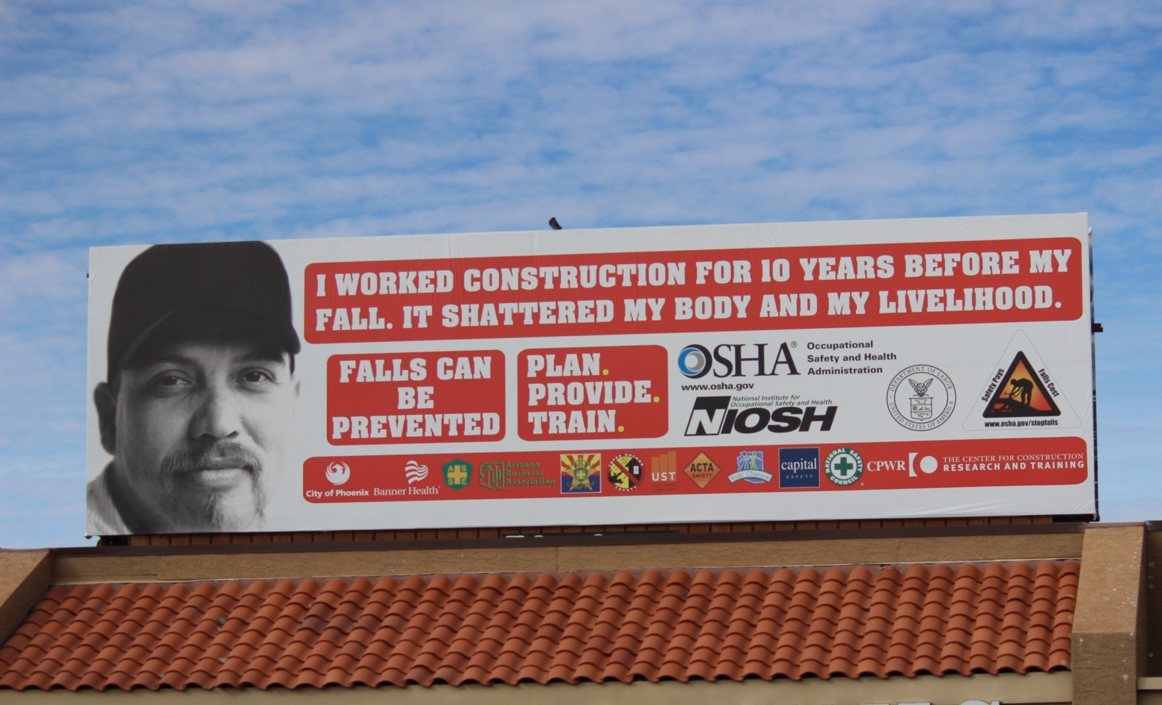
Construction Falls Prevention Campaign
2015 will be the 4th year of the campaign!
Photo source: Arizona Chapter National Safety Council
Notes:
Explain launch in 2012 …. See slide.
On Workers’ Memorial Day, April 28, 2013, we will begin the second year of the campaign. We will continue to add to our websites and to provide contractors and trainers with clear fall prevention information that’s been vetted by professionals.

Slide 15
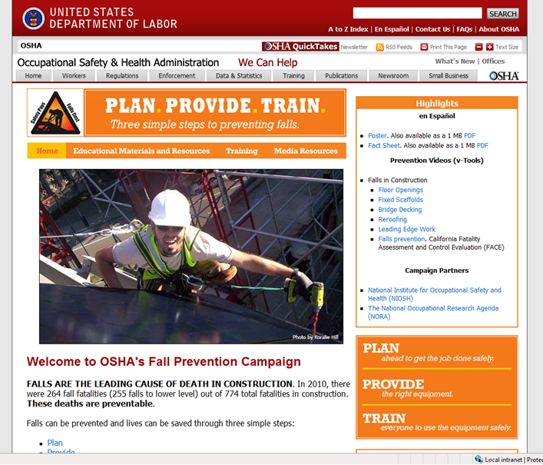
Websites
OSHA
PLAN. PROVIDE. TRAIN. Safety Pays. Falls Cost.
CPWR
National Fall Prevention Campaign Website
www.stopconstructionfalls.com
Notes:
Our campaign’s focus for information is online through several websites …
Posters and materials can be ordered for free through the OSHA website. All the information found on Stop Construction Falls.com is free.
Redundancy of posted information across these websites.

Slide 16
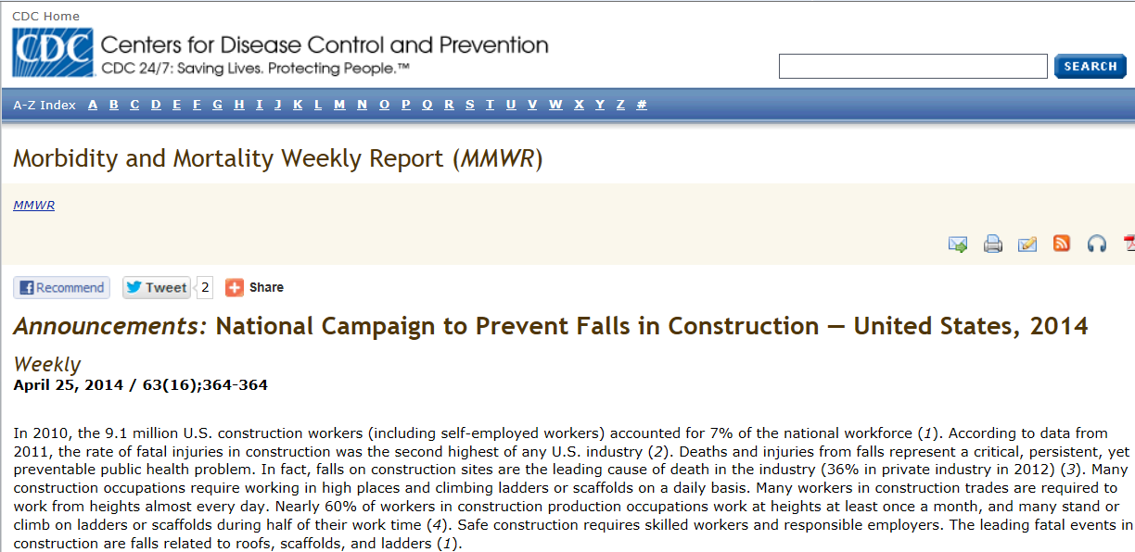
NIOSH 2014 Campaign Products
MMWR Announcement on the National Safety Stand-Down to Prevent Falls in Construction in support of the national campaign to prevent construction falls
NIOSH video: “A construction framer talks about protecting his crew from falls” at http://youtu.be/MFthzInDdLQ

Slide 17
NIOSH Directory of Construction Resources
http://www.cdc.gov/niosh/construction/
Twitter
http://twitter.com/NIOSHConstruct
Christine Branche
NIOSH Construction Program Manager|202-245-0625|cbranche@cdc.gov
The findings and conclusions in this presentation have not been formally disseminated by the National Institute for Occupational Safety and Health and should not be construed to represent any agency determination or policy.

Slide 19
Stand Tall, Stand Proud and Stand-Down for Fall Safety!
Jim Maddux
Directorate of Construction

Slide 20
2014 National Stand-Down
First ever
It was a tremendous success.
Over 1 million workers in all 50 states and internationally participated.
Approximately 5,000 “Certificates of Participation” were issued.
Nearly 50% issued to stand-downs with 25 workers or less.

Slide 21
2014 National Stand-Down
Over 150 public events were held across the country.
Over 50,000 workers participated in stand-downs outside the United States.
First certificate issued was to a company in Oman.
650,000 US Air Force active duty, reserves and civilian personnel participated.

Slide 22
2015 National Stand-Down May 4-15, 2015
Last year’s successes lead OSHA to extend the Stand-Down into a two-week event.
First week will coincide with:
National Construction Safety Executive’s Safety Week events.
ASSE’s NAOSH Week.
Goals
Reach over 3 million workers.
Over 20,000 individual Stand-Downs.

Slide 23
How do You Hold a Stand-Down?
Companies conduct a Safety Stand-Down by stopping work and providing a focused toolbox talk on: Ladders, Scaffolds or Roofs
Equipment inspections
Whatever works in your situation
Stand-Down events can be listed on the OSHA webpage if they are “free” and open to the “public”.

Slide 24
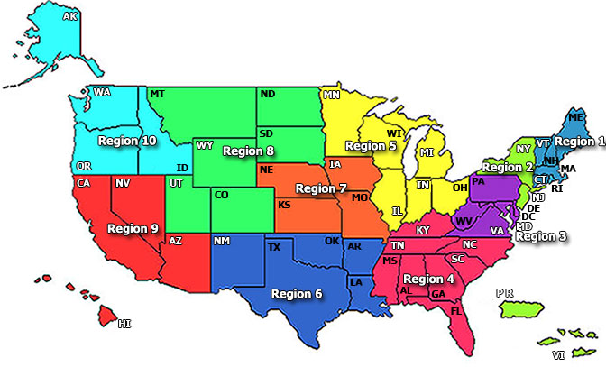
OSHA Stand-Down Resources
http://www.osha.gov/StopFallsStandDown

Slide 25
OSHA Stand-Down Resources
Region | Name | Email | Phone
I | Dale Varney | Varney.Dale@dol.gov | 413-785-0123
II | Mike Levy | Levy.Mike@dol.gov | 917-434-9515
III | James Harrity | Harrity.James@dol.gov | 215-861-4900
IV | Tom Bosley | Bosley.Tom@dol.gov | 678-237-0443
V | Gary Lescallett | Lescallett.Gary@dol.gov | 312-886-6263
 | Darnell Crenshaw | Crenshaw.Darnell@dol.gov | 312-886-6951
VI | Josh Flesher | Flesher.Josh@dol.gov | 972-850-4186
 | Judy Stevenson-Ortiz | Stevenson-Ortiz.Judy@dol.gov | 972-850-4171
 | Travis Clark | Clark.Travis@dol.gov | 972-850-4178
VII | Brian Wood | Wood.Brian.L@dol.gov | 816-283-8745
 | Jacalyn Wheeler | Wheeler.Jacalyn@dol.gov | 816-283-0545 x253
VIII | Matthew Finnigan | Finnigan.Matthew@dol.gov | 303-844-7014
 | Brad Baptiste | Baptiste.Brad@dol.gov | 720-264-6555
IX | Jose Benavides | Benavides.Jose@dol.gov | 415-563-2573
X | Dale Cavanaugh | Cavanaugh.Dale@dol.gov | 206-757-6675

Slide 26
OSHA Stand-Down Resources
Fall Stand-Down Posters (English & Spanish)
Fall Prevention Campaign Poster (English & Spanish)
Fall Prevention Fact Sheet (English, Spanish, Polish & Russian)
Fall Prevention Wallet Card (English, Portuguese & Spanish)

Slide 27
OSHA Stand-Down Resources
Fall Prevention: Safety Pays. Falls Cost. Sticker(English & Spanish)
Fall Prevention: Training Guide - A Lesson Plan for Employers (English & Spanish)
Ladder Safety: Falling Off Ladders Can Kill: Use Them Safely (English & Spanish) New
Lots of fact sheets, fatal facts, etc. available on OSHA’s web page

Slide 28
After the Stand-Down
Receive a “Certificate of Participation” for holding a Stand-Down.
Secretary of the Department of Labor saying thank you for participating.
Go to the Stand-Down certificate webpage after your stand-down, complete a short survey, then print your certificate.
Share your stand-down experience and pictures with us for possible posting on the webpage

Slide 29
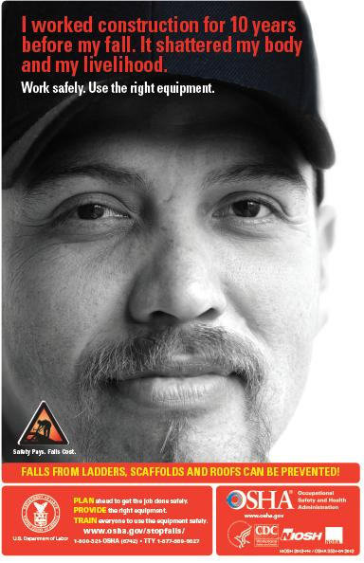
Falls Can Be Prevented
PLAN ahead to get the job done safely.
PROVIDE the right equipment
TRAIN everyone to use the equipment safely
Notes:
Other outreach materials:
Fact sheets, videos, and other outreach material available on OSHA’s website, and from OSHA regional offices.
Poster and Fact sheet has a white space to place company logos to personalize if they wish.
On behalf of the Agency, we invite you to join in this effort by helping to reach workers and employers in your shop with the resources you will find on OSHA’s dedicated website which will be available by the kick-off. OSHA plans to continue to add new information and tools to this page throughout the year.

Slide 30
What You and Your Locals Can Do
Put up posters in the locals
Work with your employers and encourage them to hold stand-downs
Organize events

Slide 31
What You and Your Locals Can Do
Get publicity, local newspaper articles
Get a Stand-Down certificate
Share your stand-down experience and pictures with us for possible posting on the webpage

Slide 32
?

Slide 33
CPWR UPDATE
Chris Trahan

Slide 34
Stand-Down 10-Day Plan
Print formatted PDF:
http://stopconstructionfalls.com/wp-content/uploads/2015/03/2015-Stand-Down-10-Day-Plan.pdf
Webpage:
http://stopconstructionfalls.com/?page_id=1831

Slide 35
Hardhat Stickers
Email falls@cpwr.com to order.

Slide 36
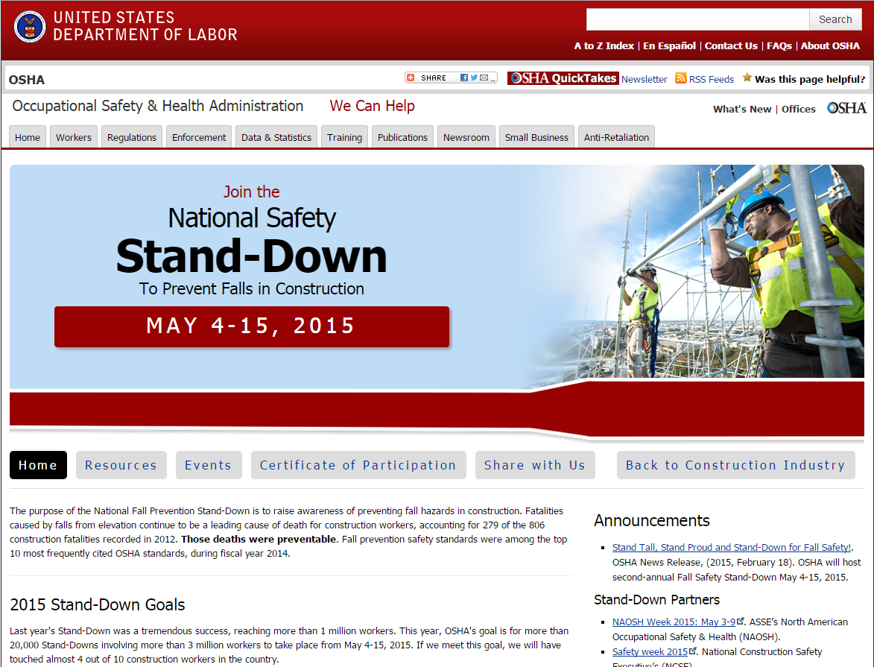
Register Your Events with OSHA
Notes:
Go to events section of OSHA Falls Stand-Down page. In addition to listing regional events, it has the list of regional coordinators Dean shared earlier. Contact your regional coordinator to for more information about hosting an event and posting it on this Events page

